Slide 1
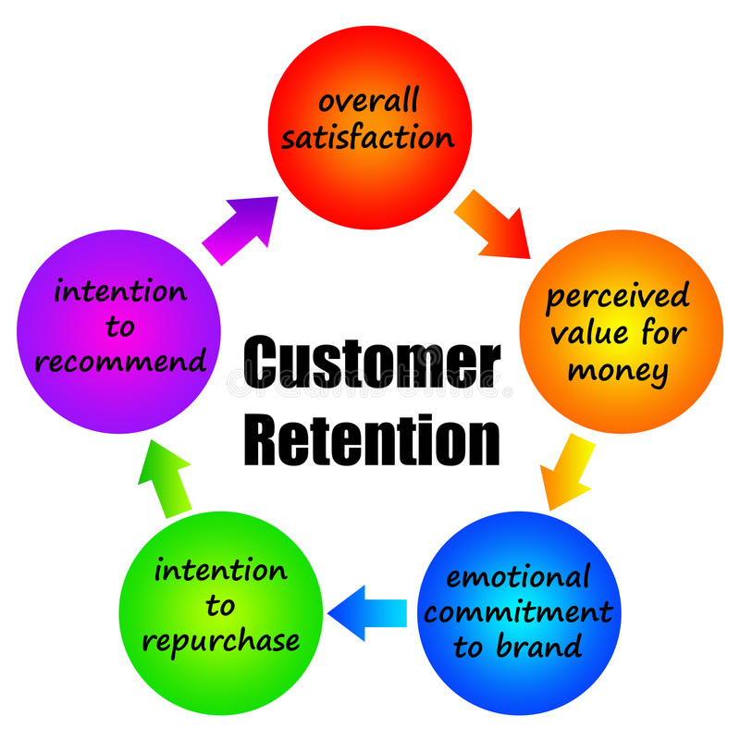
Customer retention

Slide 2
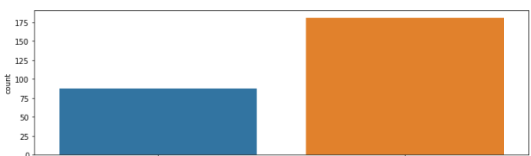


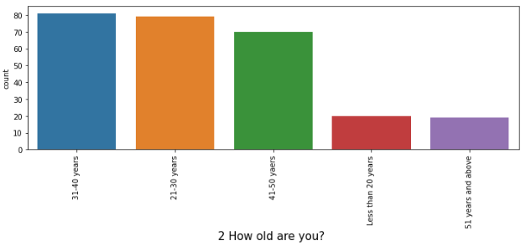
Gender of respondent
Comparing to male female count is high it indicates that comparing to male females are using online shopping more
observation
male
female
Age group of the customers or users
<20 years
People who are less than 20 years are using less count that means they are not much using online shopping
b/w 21-30years
Between the age group 21-30y is very high we can see it indicates this group people are using online shopping very frequently
observation
b/w 31-40years
Between the age group 31-40y is almost same as 21-30 and also it is little high compared to group 21-30
b/w 41-50years
this age group customers also having good number but comparing to above 2 categories it is less count it indicates that as age increases interest of shopping is decreases
Conclusion:- 1)customers who are between the age group of 21-50 years are using online shopping websites/applications are most 2)As age increases the count of customers are decreases we can say
>51 years
After reaching certain age shopping is becomes unimportant thing that is it indicates

Slide 3
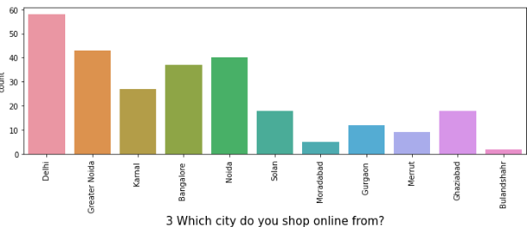
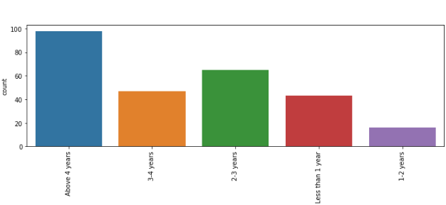
City of the customer
We can see that customers who are belongs to delhi is high count and greater Noida, Noida and bangalore The least count of customers are belongs to bulandhshahr ,moradhabad,merut,Gurgaon and gaziabad We can say that customer count is high in big cities which has high employment opportunities The customer count is low in some cities because of non-development area Conclusion :- most of the customers are belongs to well known cities like delhi,bangalore,Noida etc because employment opportunities is high comparing to other cities
observation
Most of the customers are using online shopping / application since above 4 years it means customers are trust that application/website And next category of the customers are using 2-3 years these group customers are knowing about the application /website lately comparing to above category customers < one year count is also good it indicates that customers are interested to use for long time 1-2 years count is low comparing to others it indicates that customers are convert to another applications /websites after using same application/website Conclusion:- the plot indicates that most of the customers are interested to keep application for a long time since they trust that
Since how long your shopping online
observation

Slide 4
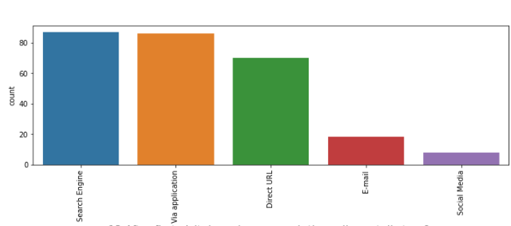
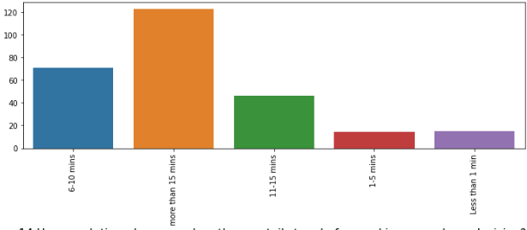
After first visit how do you reach the online store
We can see that most of the customers are visiting online store through search engine and also via application it indicates that customers are interested to shop/purchase again and again Less count category is social media it indicates that there is not much promotions are being conducted by respective online store/application Email has good number comparing to social media so it indiacates online stores advertise their products through email is high comparing to social media
observation
When a customer wants to buy something through online he/she must visit the store/application so after entering the store it takes the condition what we want and which type of the product we want and also it suggests that similar products in this process customers needs to be longer time that’s why most of the customers are above 15 mins and 6-10 min category There another category less than one min it is not makes that much sense but is possible when the limited offers time it is possible because of rush purchases customers are rush to pay the amount for particular products and another category 1-5 also same
How much time do you explore e retail- store before making a purchase decision
obseravtion

Slide 5
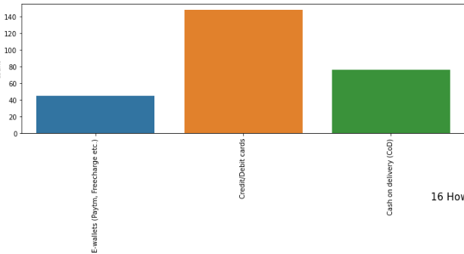
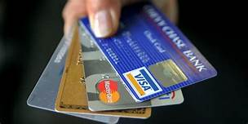
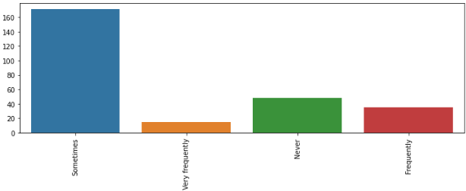
Payment method
Most of the customers are interested to pay the amount through cards(credit/debit) because most of the time offers are related to some credit /debit cards so customer pay through cards There is another category that is cash on delivery most of the customers are making this type of purchase because they thought that online payment is not secure but at any way they has to pay the bill for respective product but it gives some satisfaction to them E-wallets it the least category here but now a days these are very popular here this count is less because some of the application are not working well at the time of purchase and some other reasons customers unable to pay through e-wallets Conclusion:- it is better to provide more payments options, this may lead to buying product more
observation
Here most of the customers are abandon their cart only sometime because they may find another best offer but it is good to see this category has high count of customers Another category is never it means they do not abandon cart because they trust and they want to buy at any way frequently and very frequently are has low count
How frequently abandon your shopping cart
observation

Slide 6
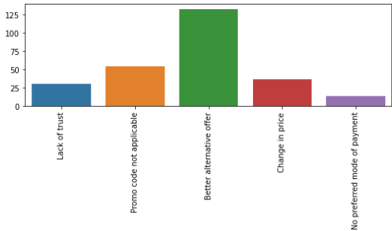
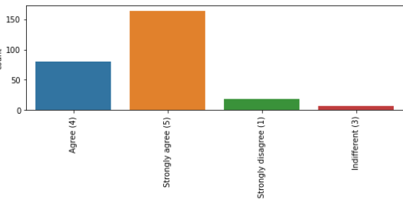
Why did you abandon the bag/shopping cart
The content on the website must be readable and understandable
➔ Here most of the customers are strongly agree to content in the application must be understandable
➔ Most of the customers are abandon bag due to better alternate offers
observation
observation

Slide 7
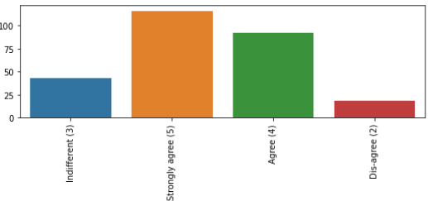
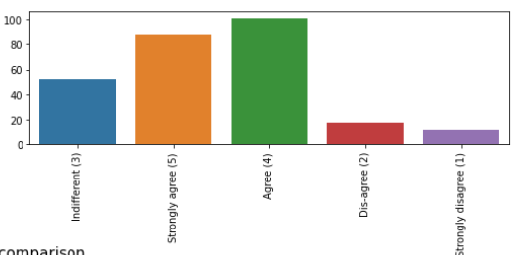
Information on similar product to the one highlightedis important for product comparison
➔ this feature tells that when a customer highlated one product in website similar product details are appearing to him this will helps to decide which one is better to buy and we can see that most of the customers are strongly agree for this
observation
➔this feature tells that complete information of the product is helps in the process of purchasing most of the customers are belongs to strongly agree and agree category
Complete information on listed seller and product being offered is important for purchase decision
observation

Slide 8
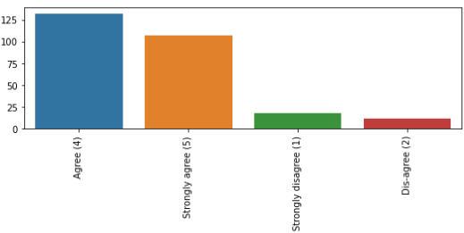
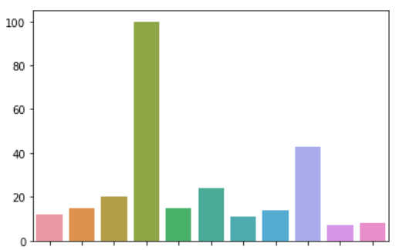
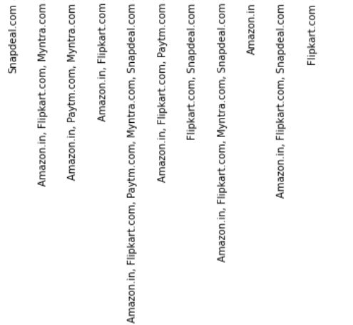
All relevant information on listed products must be stated clearly
Complete, relevant description information of products
observation
Here we can see that most of the customers count is agree and strongly agree Strongly dis-agree and dis-agree count is less because most of customers wants to relevant information of the listed products Amazon and flipkart are the websites which are best to gives the relevant information of the listed products But individually amazon is the best one and flipkart is not that much good as compare to the amazon Conclusion:- complete and relevant information of the product gives clarity to the customer so it is mandatory to maintaine clear cut information of the product and also it helps to customer satisfaction

Slide 9
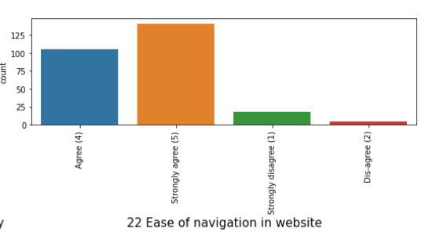
➔Ease of navigation in website:-
this feature tells that we can track our product from that respective application it represents transperancy

Slide 10
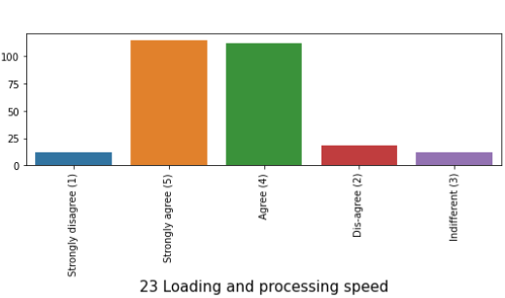
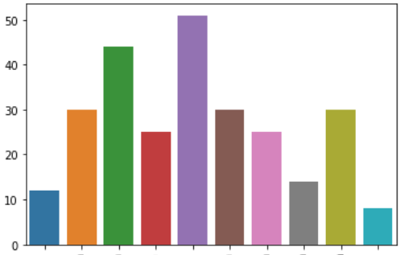
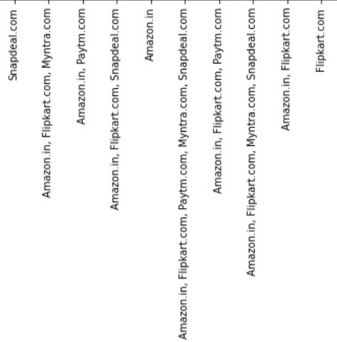
Loading and processing speed
Fast loading website speed of website and application
observation
Fast loading and speed processing is one important thing in the online website or application and also it reduce the customers waiting time this helps in the terms of customer satisfaction also
We have some websites in the right side we can see that fast and speed processing website is amazon and amazon and paytm and the least one is flipkart
Coclusion:- it is mandatory to maintain good processing speed of the application other wise it will not reach expected visitings of the customers

Slide 11
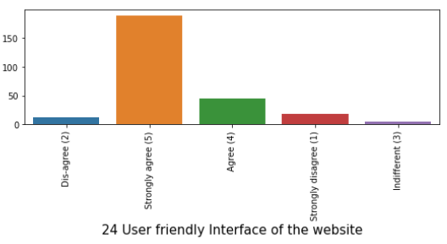
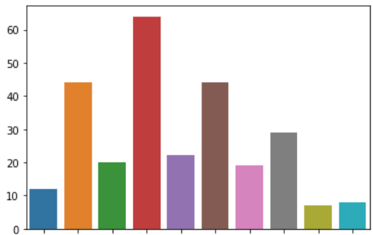
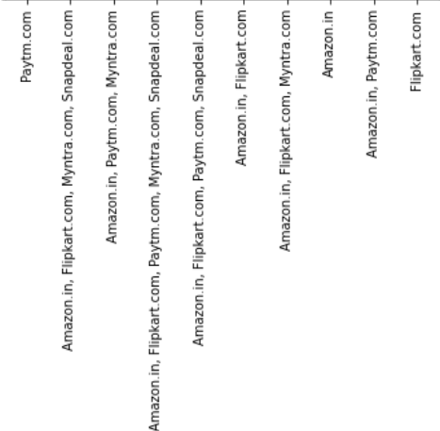
User friendly interface of the website
Easy to use website or application
Here most of he customers are strongly agreed for user friendly interface of the website and next highest category of the customers are agree
Here from right side plot indicates that which website has user friendly and easy to use ,
We can observe that all the applications are user friendly and easy to use we can say ,but the highest rating is combination of amazon,flikart ,paytm,mytra and snapdeal it indicates that most of the customers are using this applications a lot
observation

Slide 12
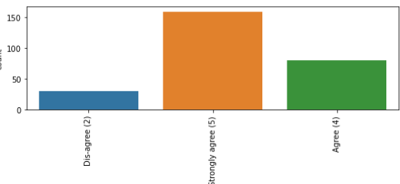
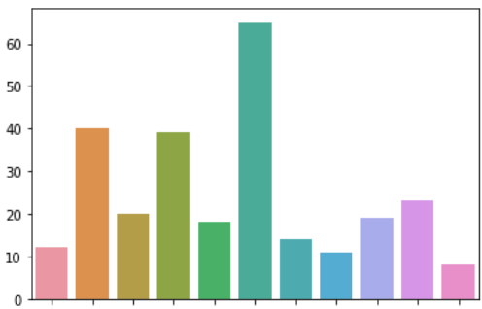
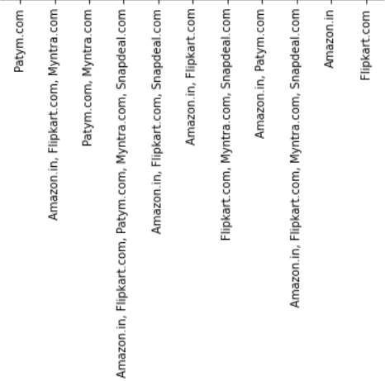
Sevaral payment methods
Convenient payment methods
Plot :-1
From plot 1 we observe that most of the customers are giving best rating for convenient payments so here we note that convenient payment method will helps a customer who unable to understand the critical steps of the payment methods so this is one of the important aspect of the application /website And also there is less count category is Dis-agree this means customers who are not satisfy with the payment method so there is some issues to resolve in payment method From the plot 2 we can see that there are several payment methods available in the websites of amazon and flipkart and one more thing is individually flipkart is less count so individually amazon is the best web site to provide several payment options And remaining all are maintan good count
Plot :-2

Slide 13
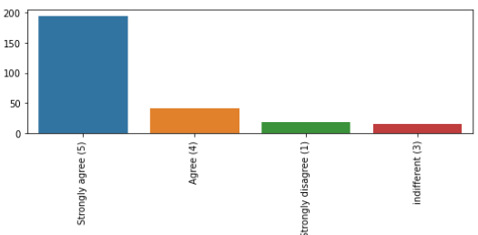
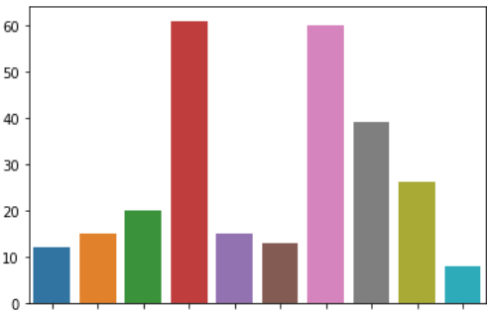
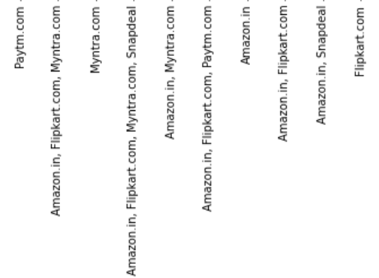
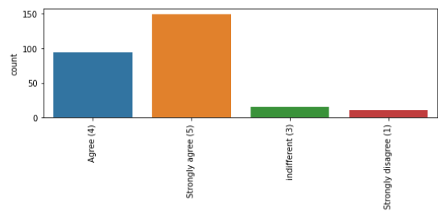
observation
Resolving customer queries is one of the important thing for online store From plot 1 and 2 are indicates that most of the customers are strongly agree and agree category only From plot3 tells that assistance through multi channel we can see that comination of amazon and flipkart and mytra and snapdeal are high count and also individually amazon has high count and flipkart is lower than all the stores. Finally highest and best customer assistance store is amazon and least one is flipkart Conclusion:- customer assistance is one the important aspect for online stores
Empathy (readiness to assist with queries) towards the customers
Plolt-1
Presence of online assistance through multi-channel
Plolt-3
Responsiveness, availability of several communication channels (email, online rep, twitter, phone etc.)
Plolt-2

Slide 14
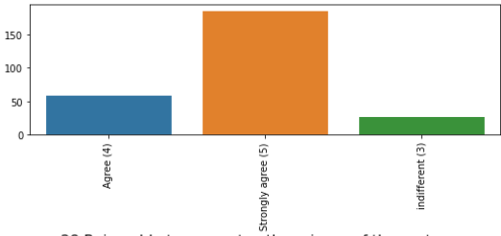
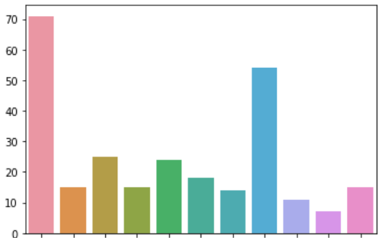
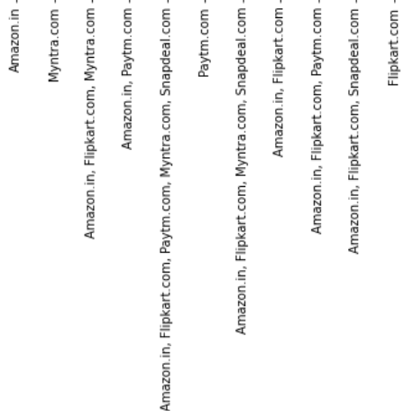
Plot-1
Obsrvation
Privacy of the customer information is one of the most important feature because information is more valuable thing
If a store fails to protect the customer information it leads to many issues
From plot 1 most of the count is strongly agree and agree category
➔ From the plot2 amazon is high count and the combination of amazon and flipkart is also high
Least one is when snapdeal ads to the amazon and flikart count is becomes low so individually snapdeal is lower count.
Conclusion :-
Privacy if the customer information is most important
Plot-2

Slide 15
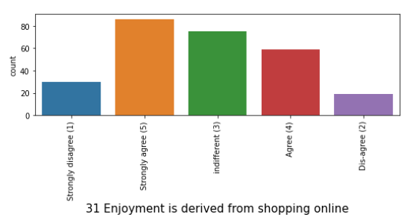


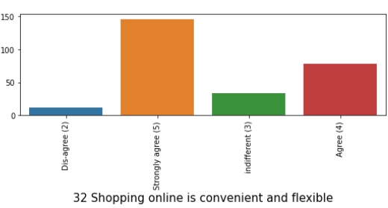
observation
if the customer satisfy with his purchase automatically he enjoy the online shopping and most of the customers are strongly agree to this and also most of the customers are belongs to the category indefferent
yes now a days we can access online shopping at any where and any time there is no restrictions to shop so online shopping is convenient and flexible and we can see that most of the customers are give strogly agreed
observation

Slide 16
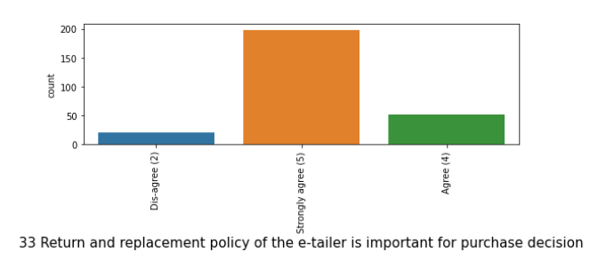
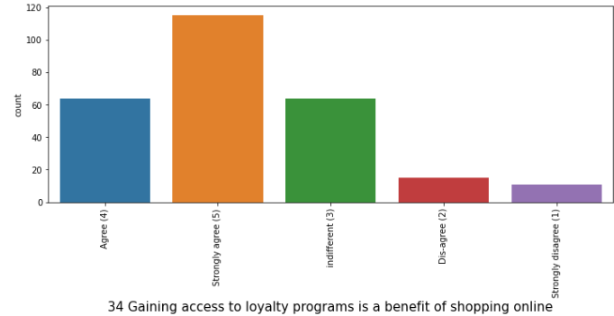
this is the one of the important feture because return policy will increase customer trust Most of the count is strongly agree ➔ Less count is disagree category
observation
most of the customers giving 5 out of 5 rating and agree and indefferent are also high count it indecates that Gaining access to loyalty programs is a benefit of shopping online
observation

Slide 17
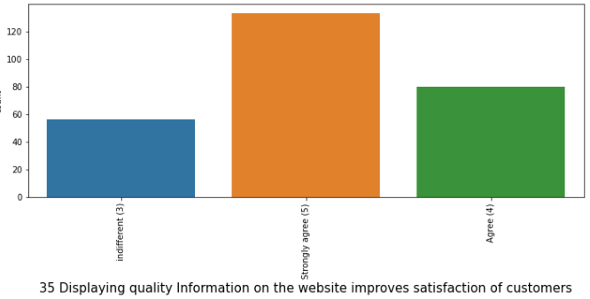
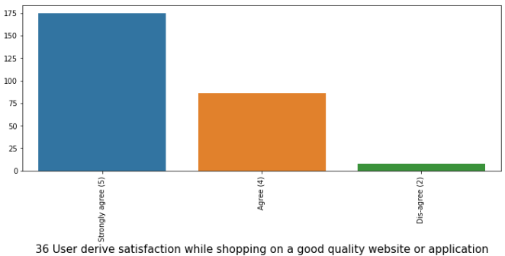
most of the customers are giving the best rating for this so Displaying quality Information on the website improves satisfaction of customers
obswervation
yes customer satisfaction is based on quality of the website or application,this feature represnts that most of the people likes quality website or application Here most of the count is strongly agree category
observation

Slide 18
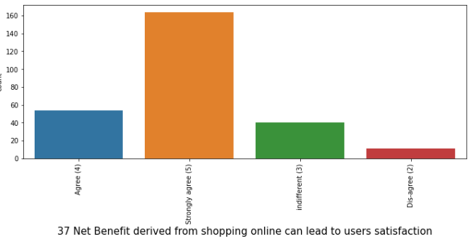
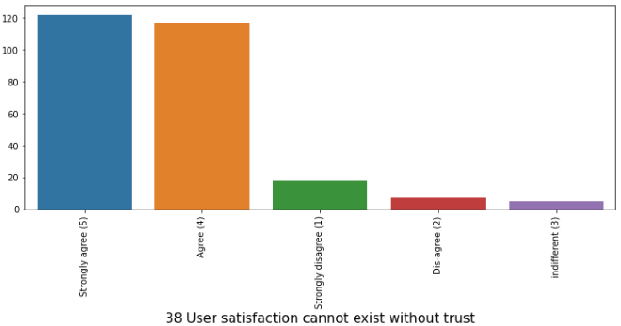
it is nothing but instant cash back or gift cards these are definetly leads to customer satisfaction there is no doubt and we can see that most of the give good rating i,e 5
observation
yes without trust user cannot stisfy himself because if he/she not trust the website or application there is less chance of purchase and visiting
observation

Slide 19
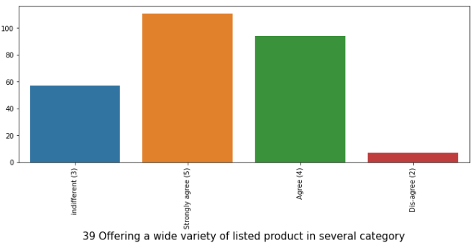
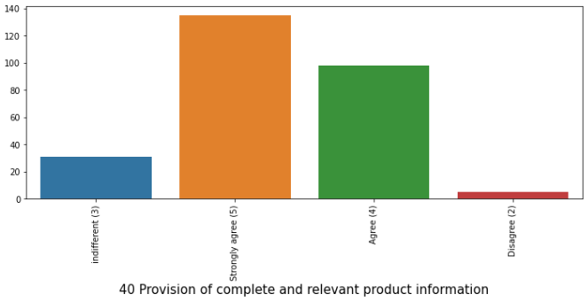
it is tells that wide veriety of products in the website,from the plot we can see that most of the customers wants more similar products
observation
Most of the customers giving strongly agree rating means it is necessary to provide provision of complete and relevant product information
observation

Slide 20
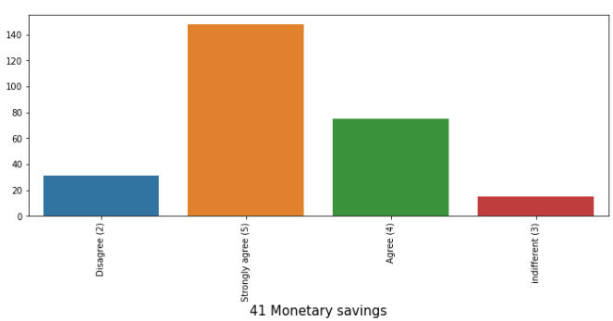
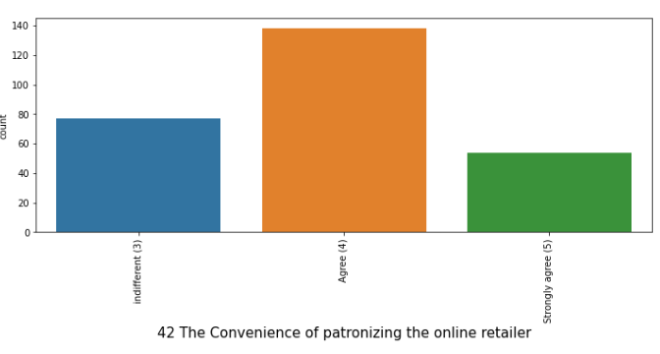
➔ through online shopping there some monetary savings are available in the form of cashbacks and in the form of gift cards as well, from the plot we can see most of the customer reviews are 5.
observation
➔ the count is high in the category of agree and indefferent is also has good number but strongly agree category is low count, and also we observe that there is no category disagree
observation

Slide 21
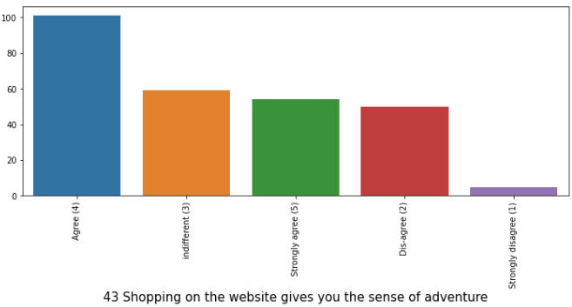
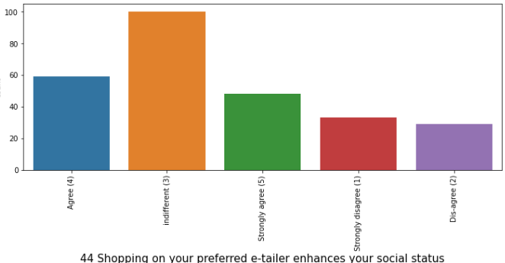
➔ most of the customers are giving that agree not strongly agree and at the same time customers who are disagree count is also high it indicates that not all the customers are feeling same for this feature
observation
➔ most of the customers are belongs to the category of indefferent so and also there is strongly disagree category count is also high so this feature not enhance your social status
observation

Slide 22
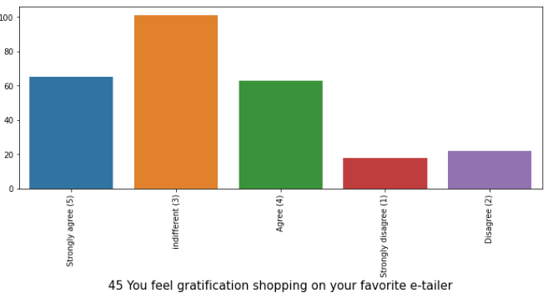
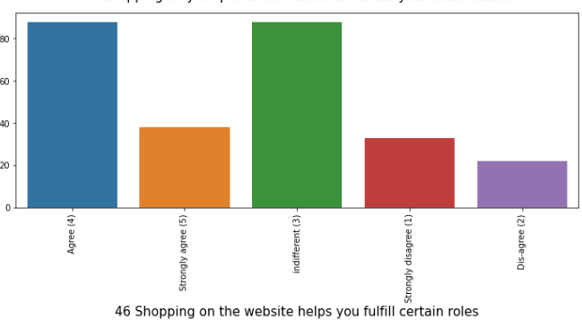
➔ most of the customers are giving rating for this feature is indifferent and strongly agree and agree are the high count so it indicates that shopping on favorite e tailer gives gratification
observation
➔ indifferent and agree counts are high in this feature
observation

Slide 23



Getting value for money spent is leads to customer satisfaction and here we can see that most of the customers ae belongs to agree and strongly agree category so it indicates that getting value for money spent is important from the right side plot we can see that it indicates that customers who are using application for shop Most of the customers are using all the applications

Slide 24
Conclusion :- From all the above plots and from the given data set most of the customers are using online shopping web sites and applications more From all the plots amazon and flipkart are more popular and remaining are also popular but features in the big applications like amazon and flipkart are not present in the othere applications like snapdeal, mytra etc Most of the customers likes easy and quick access apllications Most of the customers likes wide variety of products in the websites And suggests similar products is also an important for customers Speed and quick access helps to the customers in the process of purchase privacy of the customer information is also a important aspect And finally most of the customers are recommends amazon is one of the best individually and amazon and flipkart are next highest category of best recommendation applications

